Slide 1
Sharp Analysis for Nonconvex SGD Escaping from Saddle Points
Authors: Cong Fang, Zhouchen Lin, Tong Zhang
Presenters: Patrick Di Rita, Jerry Kong, Yuwei Qin, Flora Sun, Jie Wang
Notes:
Hello everyone, today we are going to talk about this paper, Sharp Analysis for Nonconvex SGD escaping from saddle points, by Fang et all. The presenters are Patrick Di Rita, Jrry Kon, Yuwei Qin, Flora Sun and Jie Wang.

Slide 2
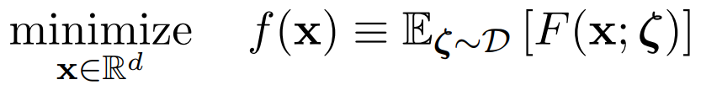
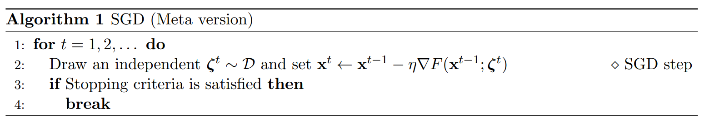
Stochastic Gradient Descent is at the center of nonconvex optimization problems
SGD in the non-convex optimization setting is:
A corresponding SGD algorithm is:
Notes:
Stochastic gradient descent is a very important algorithm that finds approximate solution to non-convex optimizataion problems efficiently in practice. The problem can be formulated in the first equation, where zeta represents distribution which we draw sample from. Down below the problem formulation is the SGD algorithm. It is very similar to gradient methods that we are all very familiar with. It replaces the gradient of the total loss term with the gradient of loss of one data sampled from zeta. In general, we are reducing the expected loss in each iteration.

Slide 3


SGD convergence rate results of non-convex problems are not mature.
𝜖-approximate first-order stationary point:
(𝜖,√ρ𝜖)-approximate second-order stationary point(SSP):
Notes:
In convex problems and in many previous approaches to the non-convex problems, we are looking for a first-order stationary point whose gradient is very small or close to zero. While this is a suffient condition for the optimality in convex case. It is not enough to use this condition to claim a point is optimal in non-convex case. Instead, the authors of the paper suggest incorporating another evaluation approximate second-order stationary point. Apart from being first-order stationary, an optimal point needs to have its smallest eigenvalue of Hessian to be no less than a small negative number, where rho is the lipschtiz constant for the Hessian. Intuitively, a point satisfying both conditions not only escape from first-order stationary point, it also doesnt have a direction that is strongly concave, which gives us more confidence in saying such point is a optimal point

Slide 4
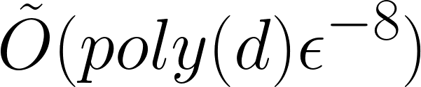
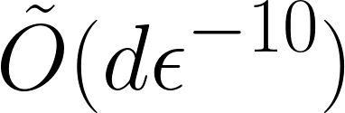
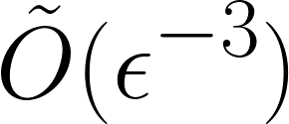
Previous Results on finding SSP
Ge et al. (2015) | Injection of spherical noise
Daneshmand et al. (2018) | Normal SGD step
Fang et al. (2018) | Variance reduction
Notes:
The literature have only few results until recently. In 2015 Ge et al provided the first theoretical result that SGD with injected spherical noise can escape from all saddle points in polynomial time. In 2018 Daneshmand derived a convergence rate linear to dimension for an ordinary SGD step. The author’s earlier paper uses a different approach that perform variance reduction before SGD to have a better computational cost.

Slide 5
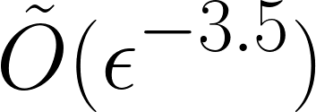
Paper’s main contribution
1, For Lipschitz-continuous gradient and Hessian objective function, the computational cost to find second-order stationary point is
2, Propose dispersive noise assumption, under which SGD escape all saddles that has a strongly negative Hessian eigenvalues
Notes:
Compared to previous results that perform SGD directly,for Lipschitz continous gradient and hessian functions, the paper proved that classical and simple SGD has a computational cost of O(epsilon^-3.5). This is an important result because it breaks the previous conjecture that the computaional cost can be no greater than epsilon^-4. Although the author’s variance reduction approach gives a O episilon^-3 result, they believe that any results better than epsilon^-3.5 needs variance reduction. The second main contribution is the dispersive noise assumption. The assumption is on the property of a function. Intuitively, it assumes that a function with noise can escape from flat regoin or saddle point with high probability in one gradient descent step. It is important because many noises satisfy this property.

Slide 6
Presentation structure
Introduction
Notation
Algorithm
Assumptions
Algorithm
Proof of convergence rate
Escaping saddles
Faster Descent
Finding SSP
Related work & Conclusion
Notes:
The presentation is organized as follows: we have given the introduction, and we will than introduce notations that many of us probably are not too familiar with. Then the main body of the proof. The paper is highly technical, we will incorporate more intuition to make it more comprehensible. Lastly, we will talk about interesting related works.

Slide 7
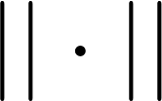
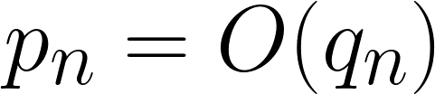
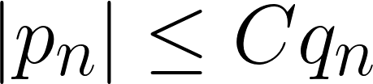
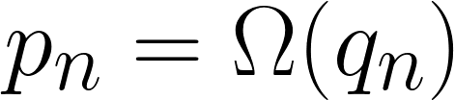
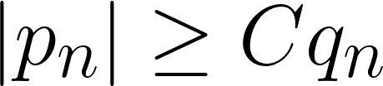

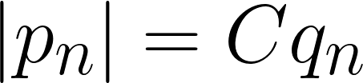
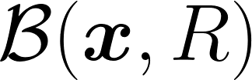
Notation
: Euclidean norm of a vector or spectral norm of a square matrix.
For sequence of vectors {p} and scalars {q}.
: R-ball around x in Euclidean distance.
Notes:
In this paper, the author uses norm to denote the euclidena norm of a vector or spectral norm of a squared matrix. The asymptotic notation is extended to a sequence of vectors. The asymptote equal sign resembles that of big theta notation. and it uses B to represent the R euclidena ball around x.

Slide 8

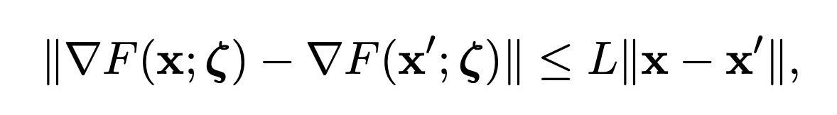
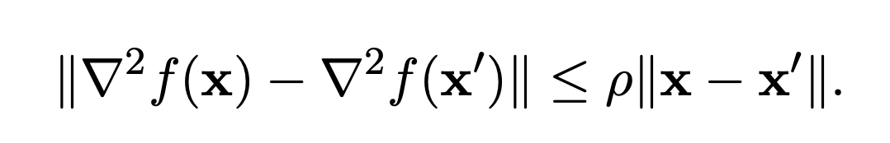
Assumptions
Assumption 1 (Smoothness): We assume that the objective function satisfies some smoothness conditions: for all x, x’ ∈ , we have:
and

Slide 9





Assumptions
Assumption 2 (Boundedness): The where
is the global infimum value of
Assumption 3 (Bounded Noise): For any x ∈ , the stochastic gradient satisfies:

Slide 10

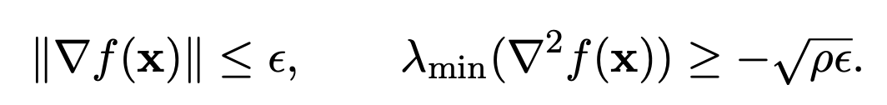
Definitions
Definition 1 (Second-order Stationary Point): Call x ∈ an 1111111 -approximate second-order stationary point if

Slide 11
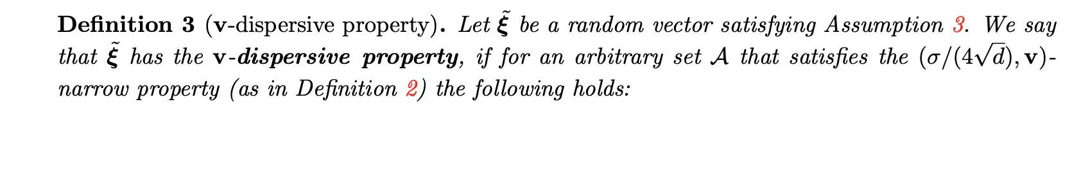
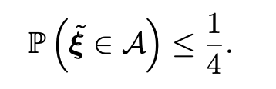
Definitions

Slide 12

Assumptions
Assumption 4 (Dispersive Noise): For an arbitrary point x ∈ ,
admits the v-dispersive property (Definition 3) for any unit vector v.

Slide 13

Convergence Analysis
The authors’re trying to answer:
Is it possible to sharpen the analysis of SGD algorithm and obtain a reduced stochastic gradient computational cost for finding an - approximate second-order stationary point?

Slide 14
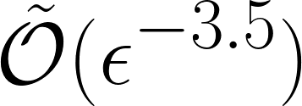
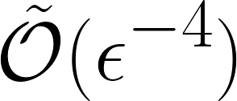
Convergence Analysis
The authors’re trying to answer:
Is it possible to sharpen the analysis of SGD algorithm and obtain a reduced stochastic gradient computational cost for finding an - approximate second-order stationary point?
The short answer is yes, they managed to prove that the algorithm will find SSP within
with Hessian constraints instead of
, which people used to believe.

Slide 15
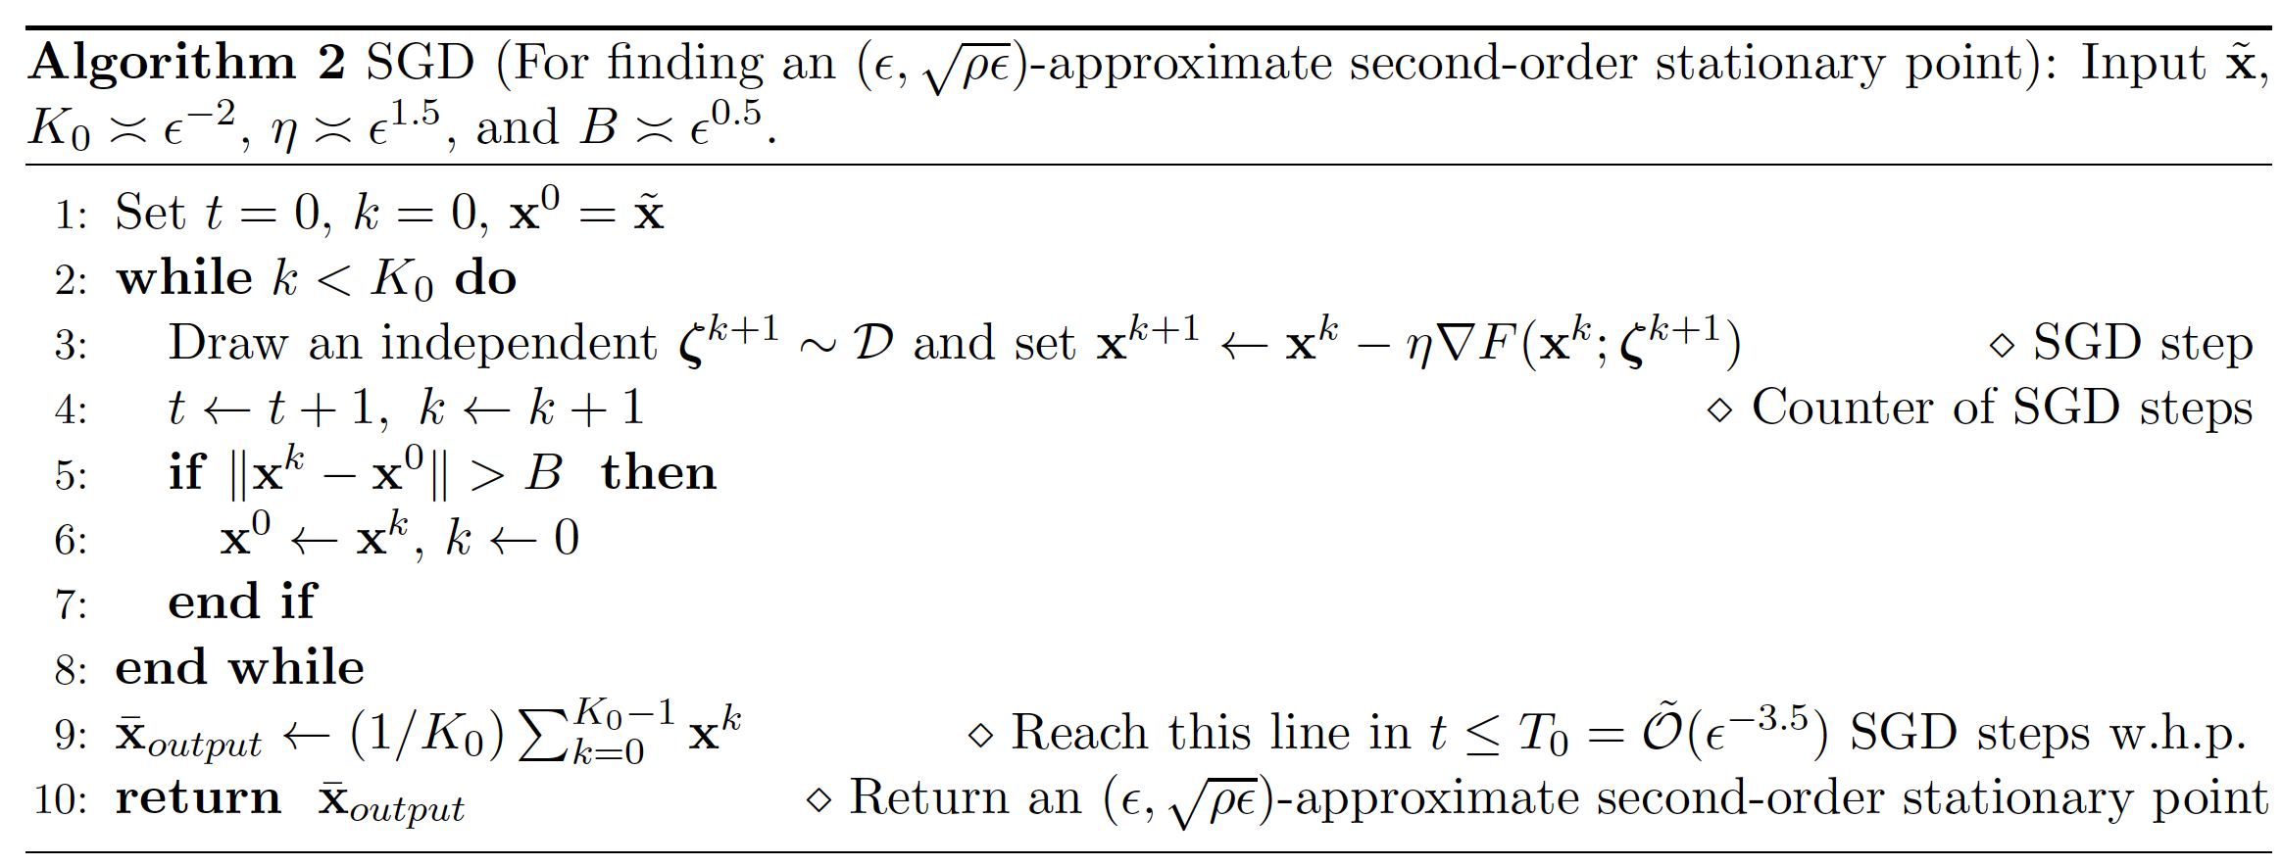
Convergence Analysis: Type Two--the Proposed SGD
Ball-controled stopping criteria

Slide 16

Algorithm
Update x using the stochastic gradient:
If x escapes the B-neighborhood of the initial point with in steps, update the initial point and restart the counting.
If not, output the average x of the last steps.

Slide 17
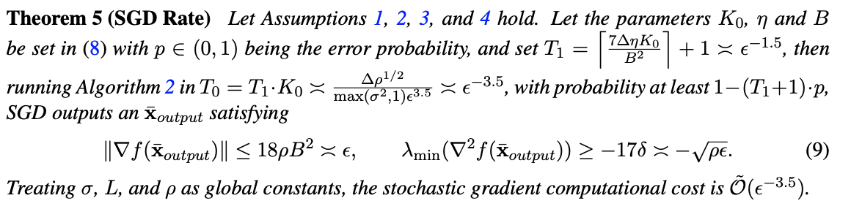
Convergence Analysis
The formal statement is:

Slide 18
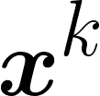
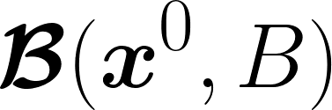
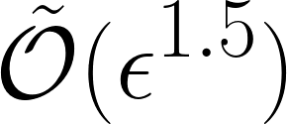
Convergence Analysis
The proof of “SGD can efficiently escape saddles” consists of three part:
with high probability, if
moves out of in iterations
Throughout the execution of the algorithm, each time moves out of , with high probability, the function value shall decrease with a magnitude at least
Once does not move out of until iteration, with high probability, we find a desired approximate second-order stationary point (SSP).

Slide 19
Convergence Analysis
The proof of “SGD can efficiently escape saddles” consists of three part:
with high probability, if
moves out of in iterations
Throughout the execution of the algorithm, each time moves out of , with high probability, the function value shall decrease with a magnitude at least
Once does not move out of until iteration, with high probability, we find a desired approximate second-order stationary point (SSP).
Key step to reduce
to

Slide 20
Convergence Analysis
The formal statement of “SGD can efficiently escape saddles” is:
part 1
part 2
part 3

Slide 21
The proof of “SGD can efficiently escape saddles”
With high probability, if
moves out of in iterations
Throughout the execution of the algorithm, each time moves out of , with high probability, the function value shall decrease with a magnitude at least
Once does not move out of until iteration, with high probability, we find a desired approximate second-order stationary point (SSP).

Slide 22



Convergence Analysis - escapes saddles’ ball space within iters
be the first time (mathematically, a stopping time) that exits the B-neighborhood of , i.e.

Slide 23
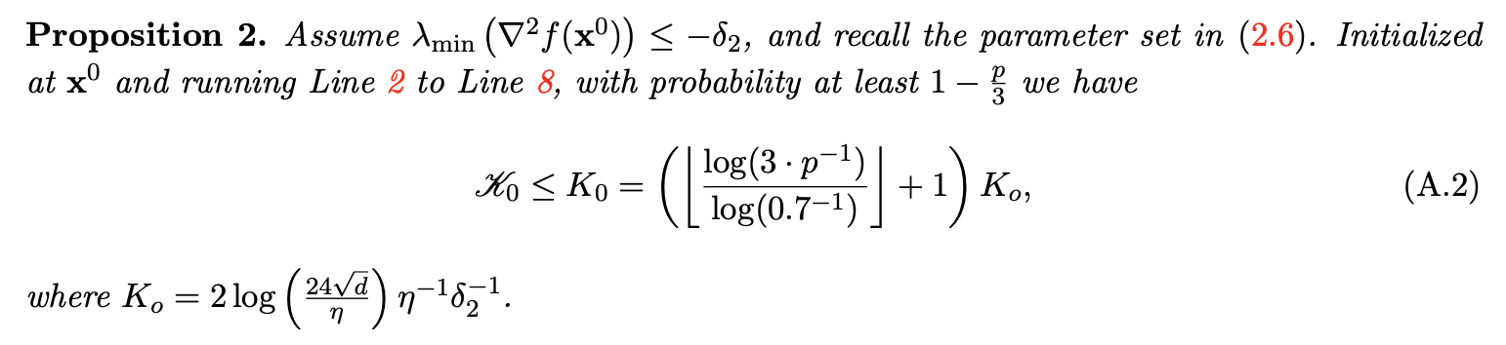

Convergence Analysis - escapes saddles’ ball space within iters
be the first time (mathematically, a stopping time) that exits the B-neighborhood of , i.e.

Slide 24






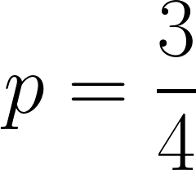

Convergence Analysis - escapes saddles’ ball space within iters
bad initialization region
If lies in this region, the probability of to escape the ball within iterations is
enjoys the -narrow property, where
Thus with , after the first step, could jump out of the bad initialization region.

Slide 25
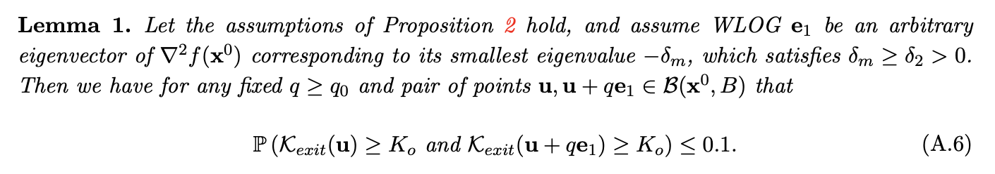
Convergence Analysis - escapes saddles’ ball space within iters
bad initialization region
If lies in this region, the probability of to escape the ball within iterations is
enjoys the -narrow property, where

Slide 26



Convergence Analysis - escapes saddles’ ball space within iters
There will be some budget iterations left after jumps out of the bad initialization region, serves as the new , and the probability for the new can escape from the ball within iterations will be high.

Slide 27
The proof of “SGD can efficiently escape saddles”
With high probability, if
moves out of in iterations
Throughout the execution of the algorithm, each time moves out of , with high probability, the function value shall decrease with a magnitude at least
Once does not move out of until iteration, with high probability, we find a desired approximate second-order stationary point (SSP).

Slide 28
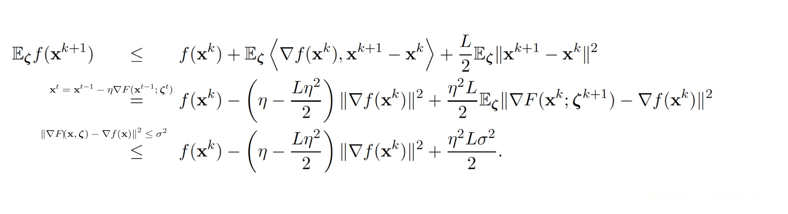
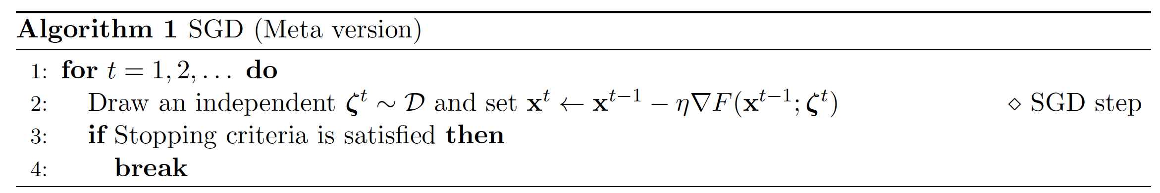
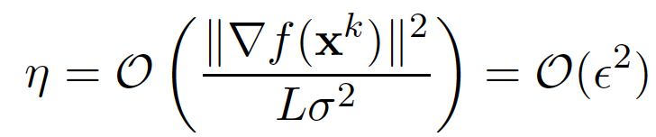
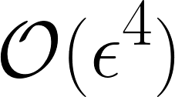
Convergence Analysis: Type One--The Classical SGD
Learning: the function value iteration would descent with a magnitude of at least

Slide 29
Convergence Analysis: Type Two--the Proposed SGD
How much the objective function can decrease once the
moves out of the B-neighborhood in iterations?

Slide 30
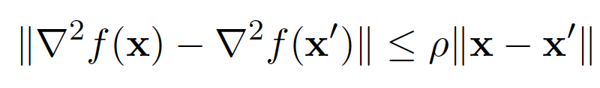

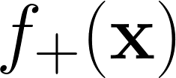
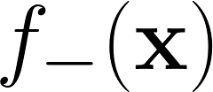
Convergence Analysis: Type Two--the Proposed SGD
The Hessian-smoothness condition:
Considering the decomposition of objective function:
Next: treating component and component separately.

Slide 31
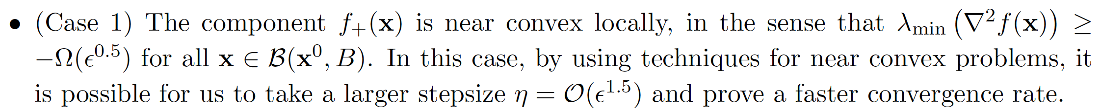
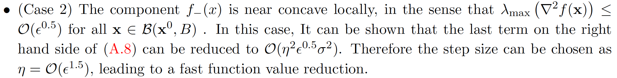
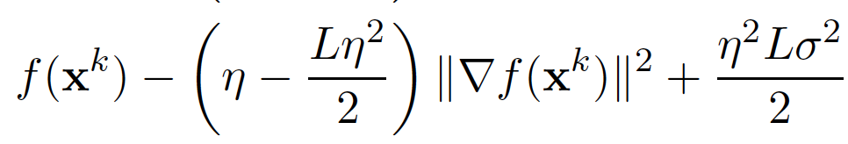
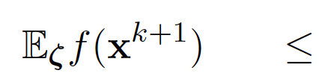
Convergence Analysis: Type Two--the Proposed SGD

Slide 32
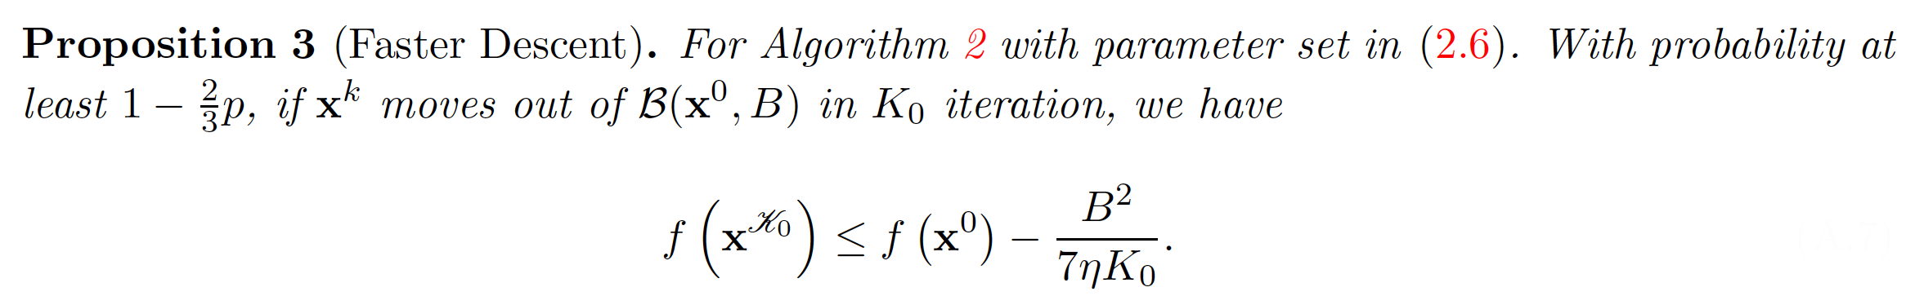



Convergence Analysis: Type Two--the Proposed SGD
Comment:
Once moves out of the ball in iterations no matter what the local surface of looks like, the function value will decrease with a magnitude of at least

Slide 33
The proof of “SGD can efficiently escape saddles”
With high probability, if
moves out of in iterations
Throughout the execution of the algorithm, each time moves out of , with high probability, the function value shall decrease with a magnitude at least
Once does not move out of until iteration, with high probability, we find a desired approximate second-order stationary point (SSP).

Slide 34
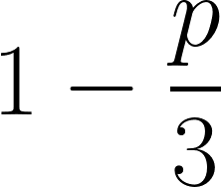
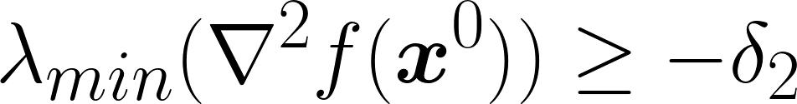
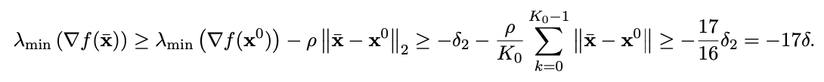

Convergence Analysis - the returned point is a SSP
With probability at least , if does not move out the ball in steps, we have ,
then due to continuous Hessian:
The returned point satisfies the second order stationary condition

Slide 35


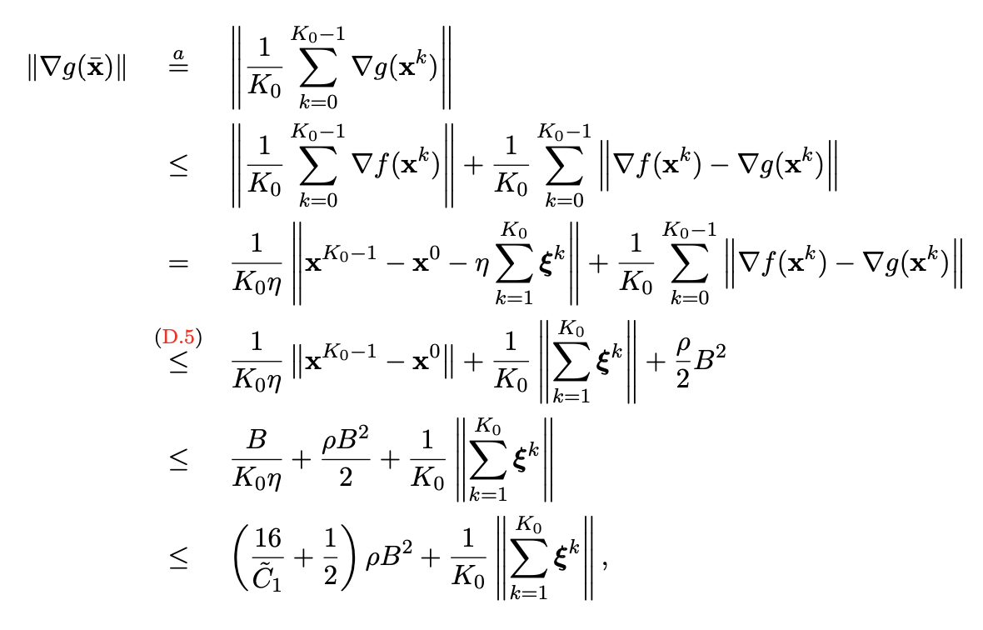
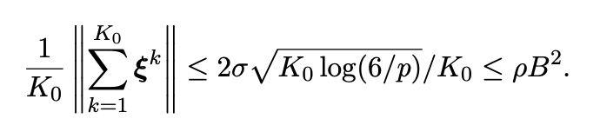
Convergence Analysis - the returned point is a SSP
First order stationary condition:
quadratic approximation of at
g is quadratic, then g is linear
triangle inequality
Definition of SGD in noise term
Proved in Lemma D.5
x does not escape the ball
Parameter definition appended on the last slide
Vector-Martingale Concentration Inequality

Slide 36





Convergence Analysis - the returned point is a SSP
First order stationary condition:
The returned point satisfies the first order stationary condition

Slide 37
Convergence Analysis -- wrap up
The formal statement of “SGD can efficiently escape saddles” is:
part 1
part 2
part 3

Slide 38

Conclusion
SGD achieves a stochastic gradient computational cost of
for finding an -approximate second order stationary point when equipped with a ball-controlled stopping criterion and Hessian-Lipschitz constraints.
Improves over the best-known SGD convergence rate of

Slide 39

Future Work
Some important questions still remain:
Does SGD achieve an even faster rate than the one found in this paper?
Conjectured that variance reduction methods are necessary to achieve an approximate second-order stationary point in fewer than steps
What is the convergence rate of SGD in solving constrained optimization problems
Can one extend the analysis in this paper to the proximal case, or even the stochastic version of Nesterov’s Accelerated Gradient Descent?

Slide 40
Thanks for watching

Slide 41

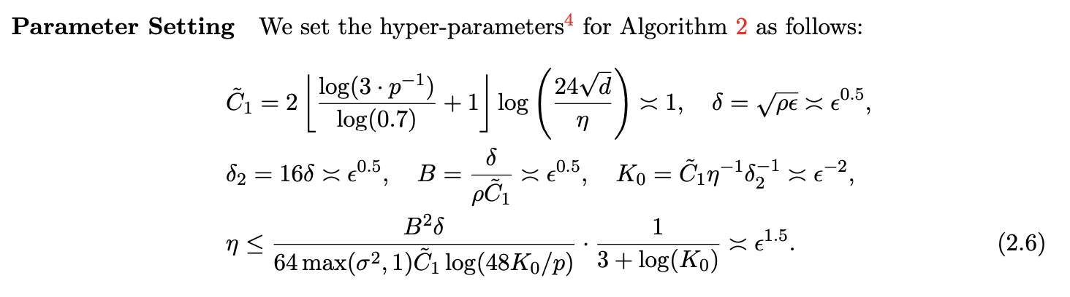
Appendix -- Parameter setting

